Slide 1
Theory of Automata
Lecture # 11-12-13-14

Slide 2
THOMPSON’S Construction Method
Convert the regular expression to an NFA
((a⋅ b)|c)*
Notes:
Divide regular expression into terms call the r’s

Slide 3
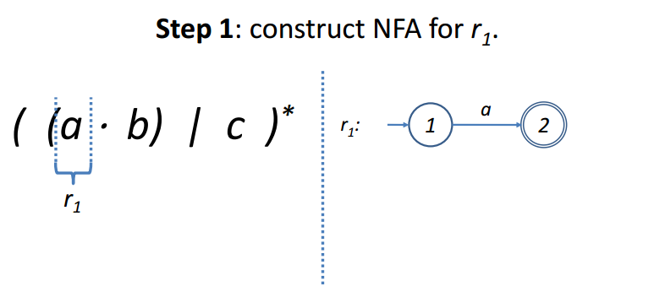
THOMPSON’S Construction

Slide 4
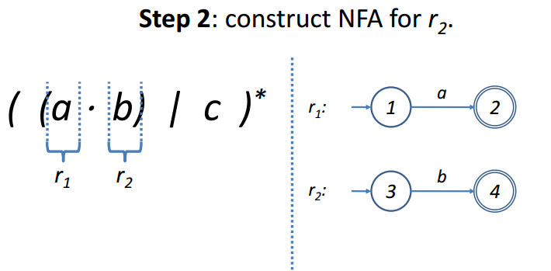
THOMPSON’S Construction

Slide 5
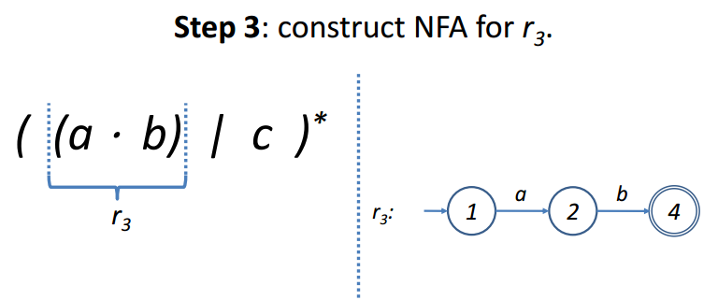
THOMPSON’S Construction

Slide 6
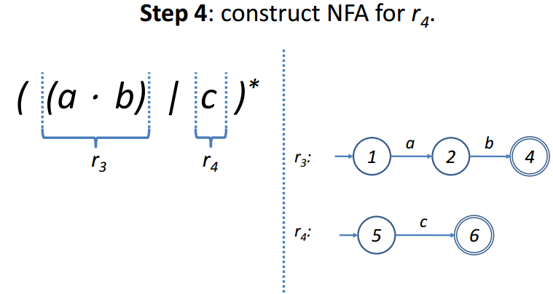
THOMPSON’S Construction

Slide 7
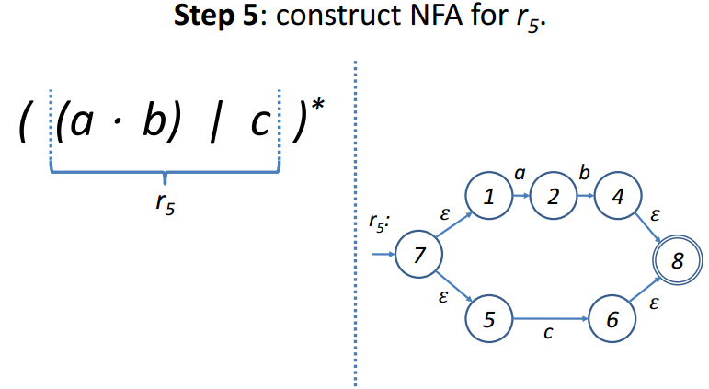
THOMPSON’S Construction

Slide 8
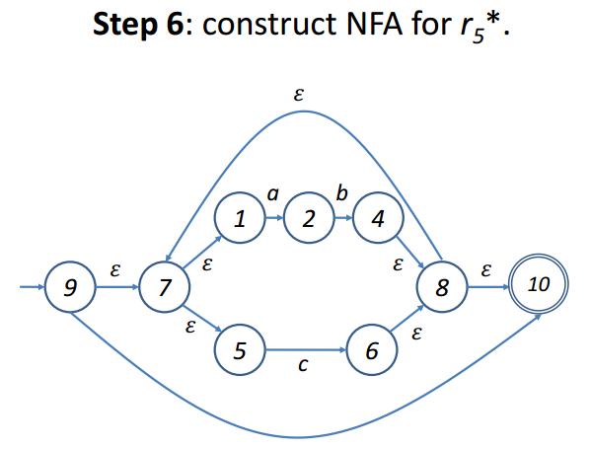
THOMPSON’S Construction

Slide 9
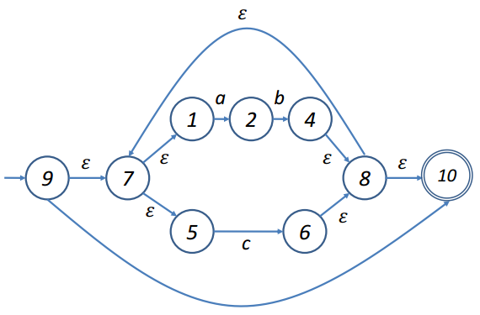
SUBSET Construction Method
Convert the NFA to a DFA

Slide 10
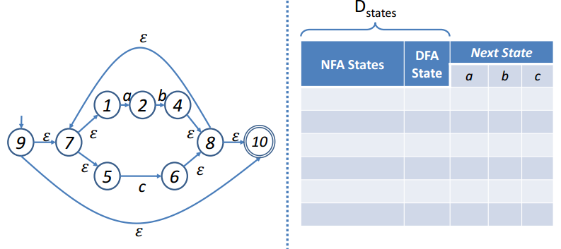
SUBSET Construction Method
Draw transition table for DFA

Slide 11
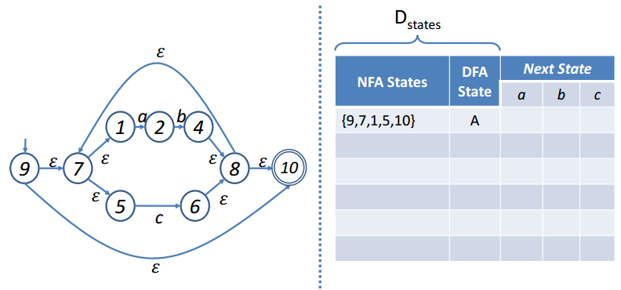
SUBSET Construction Method
Add 𝜀-closure(9) as DFA start state
Notes:
D states means DFA states

Slide 12
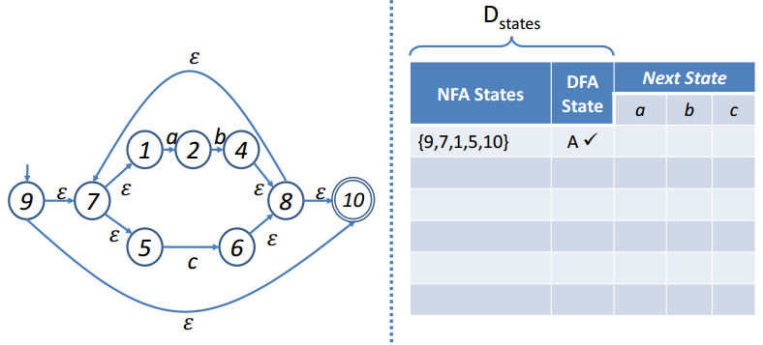
SUBSET Construction Method
Mark state A
Notes:
D states means DFA states

Slide 13
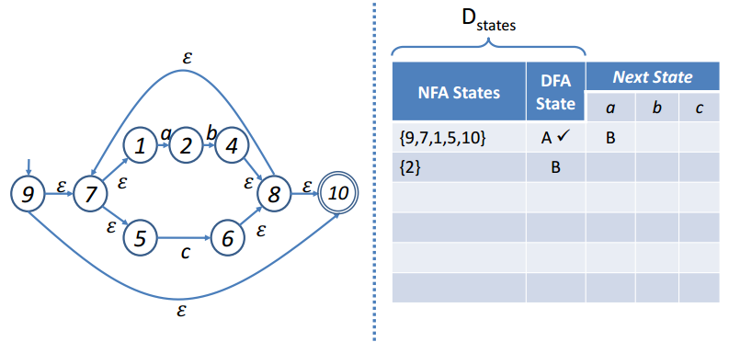
SUBSET Construction Method
Compute 𝜀-closure(move(A, a))
Notes:
D states means DFA states

Slide 14
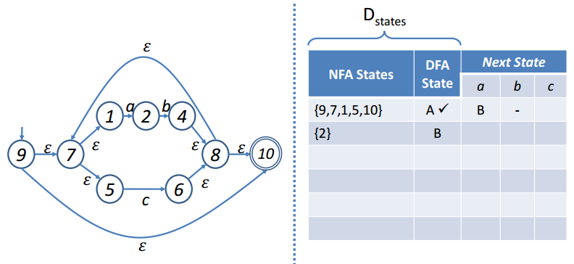
SUBSET Construction Method
Compute 𝜀-closure(move(A, b))
Notes:
D states means DFA states

Slide 15
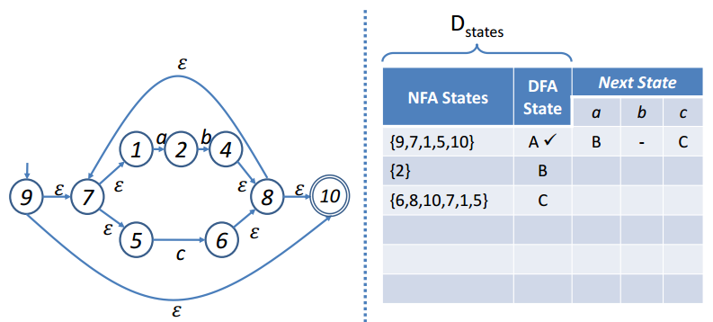
SUBSET Construction Method
Compute 𝜀-closure(move(A, c))
Notes:
D states means DFA states

Slide 16
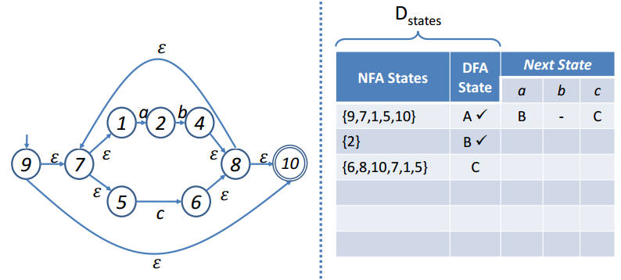
SUBSET Construction Method
Mark B
Notes:
D states means DFA states

Slide 17
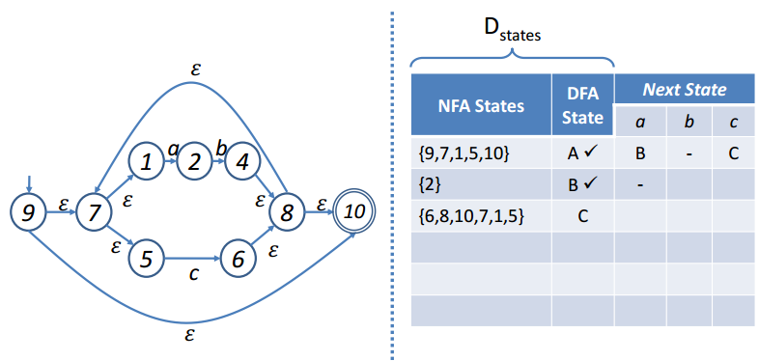
SUBSET Construction Method
Compute 𝜀-closure(move(B, a))
Notes:
D states means DFA states

Slide 18
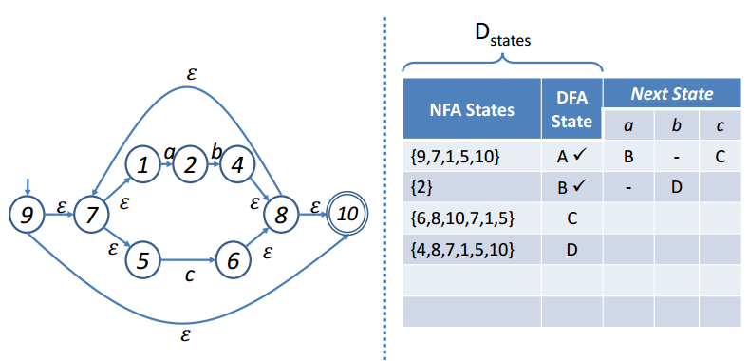
SUBSET Construction Method
Compute 𝜀-closure(move(B, b))
Notes:
D states means DFA states

Slide 19
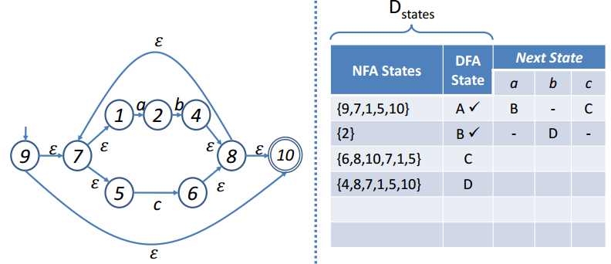
SUBSET Construction Method
Compute 𝜀-closure(move(B, c))
Notes:
D states means DFA states

Slide 20
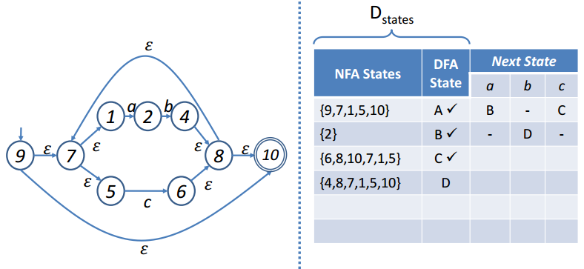
SUBSET Construction Method
Mark C
Notes:
D states means DFA states

Slide 21

SUBSET Construction Method
Compute 𝜀-closure(move(C, a))
Notes:
D states means DFA states

Slide 22
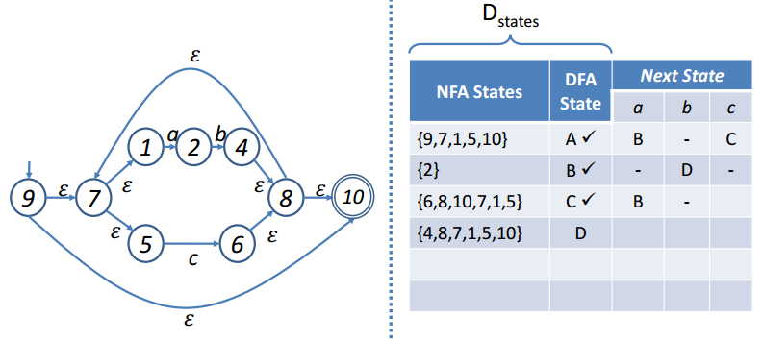
SUBSET Construction Method
Compute 𝜀-closure(move(C, b))
Notes:
D states means DFA states

Slide 23
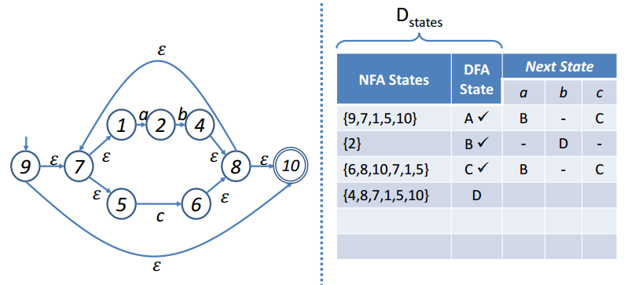
SUBSET Construction Method
Compute 𝜀-closure(move(C, c))
Notes:
D states means DFA states

Slide 24
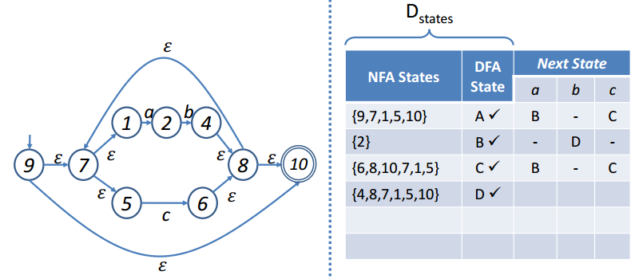
SUBSET Construction Method
Mark D
Notes:
D states means DFA states

Slide 25
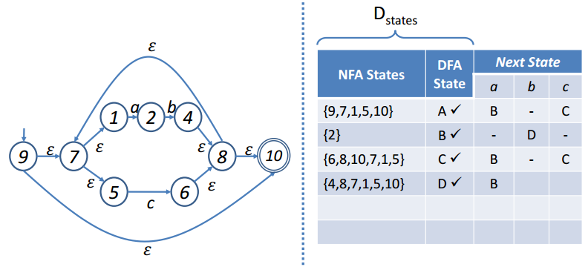
SUBSET Construction Method
Compute 𝜀-closure(move(D, a))
Notes:
D states means DFA states

Slide 26
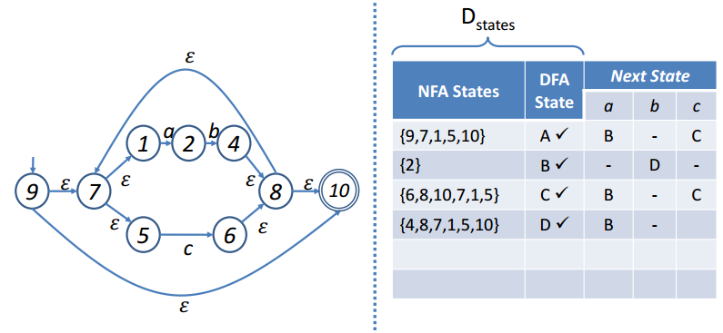
SUBSET Construction Method
Compute 𝜀-closure(move(D, b))
Notes:
D states means DFA states

Slide 27

SUBSET Construction Method
Compute 𝜀-closure(move(D, c))
Notes:
D states means DFA states

Slide 28
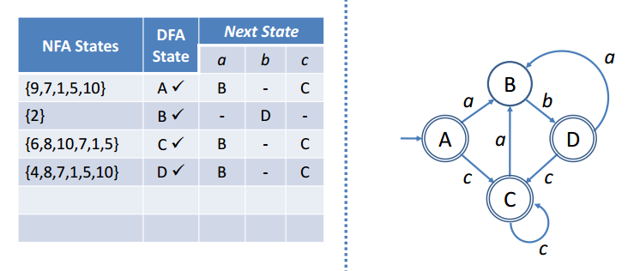
SUBSET Construction Method
Draw DFA
Notes:
D states means DFA states

Slide 29

Another Example
Notes:
D states means DFA states

Slide 30

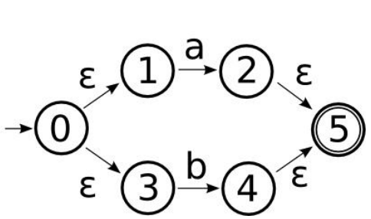
Thompson Construction
First we construct the union of a and b
Notes:
A union b thompson construction

Slide 31

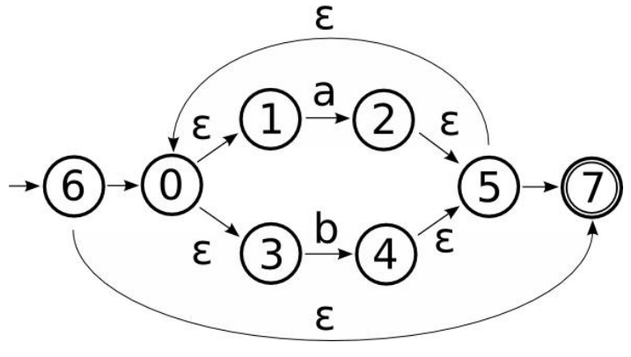
Thompson Construction
Now for kleen start
Notes:
A union b kleen start thompson construction

Slide 32
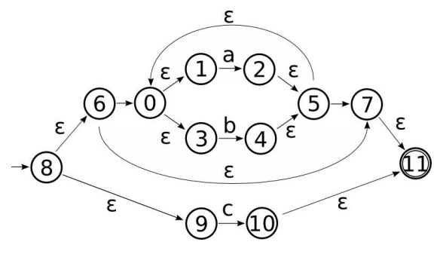
Thompson Construction
Now the union of and c is
Notes:
A union b kleen start thompson construction

Slide 33
Conversion to DFA Using Subset Construction
Notes:
A union b kleen start thompson construction

Slide 34
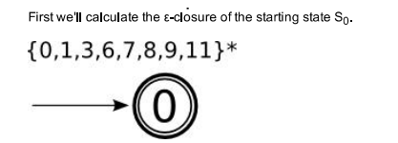
SUBSET Construction Method

Slide 35
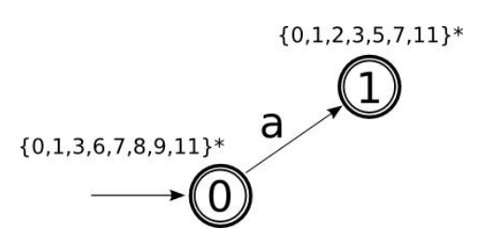
SUBSET Construction Method
Compute 𝜀-closure(move(0, a))
Notes:
D states means DFA states

Slide 36
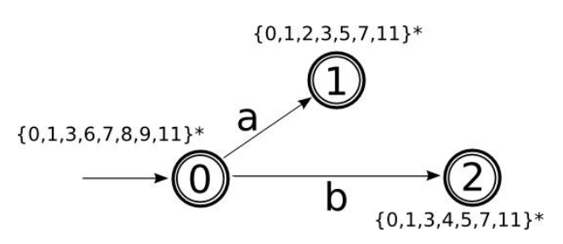
SUBSET Construction Method
Compute 𝜀-closure(move(0, b))
Notes:
D states means DFA states

Slide 37
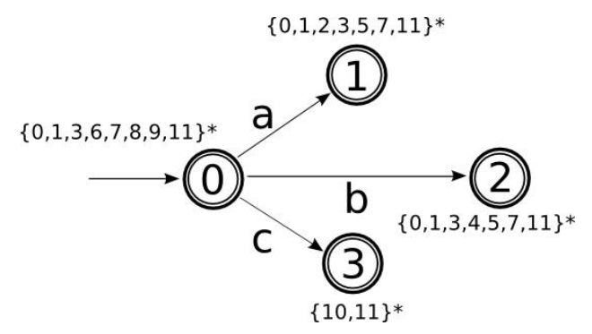
SUBSET Construction Method
Compute 𝜀-closure(move(0, c))
Notes:
D states means DFA states

Slide 38
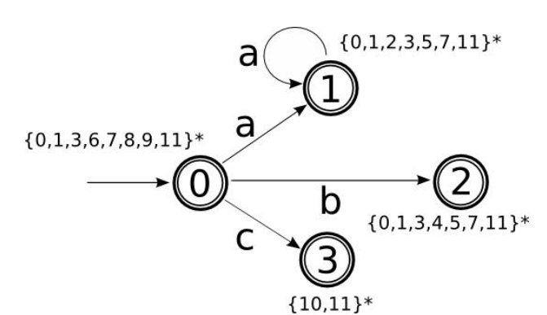
SUBSET Construction Method
Compute 𝜀-closure(move(1, a))
Notes:
D states means DFA states

Slide 39
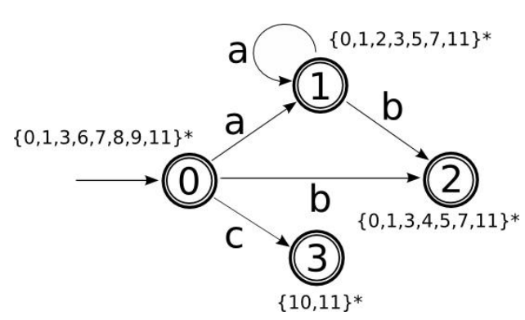
SUBSET Construction Method
Compute 𝜀-closure(move(1, b))
Notes:
D states means DFA states

Slide 40
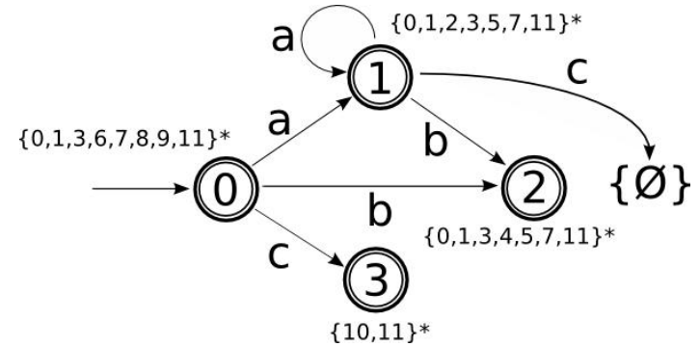
SUBSET Construction Method
Compute 𝜀-closure(move(1, c))
Notes:
D states means DFA states

Slide 41

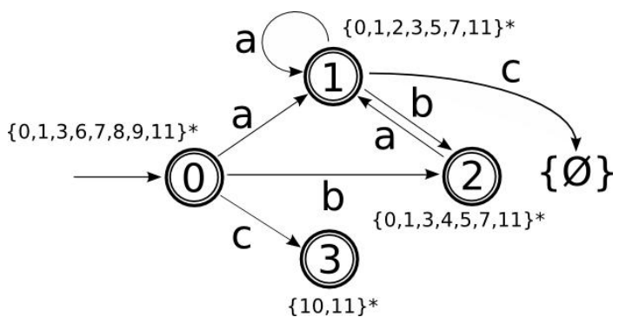
SUBSET Construction Method
Compute 𝜀-closure(move(2, a))
Notes:
D states means DFA states

Slide 42
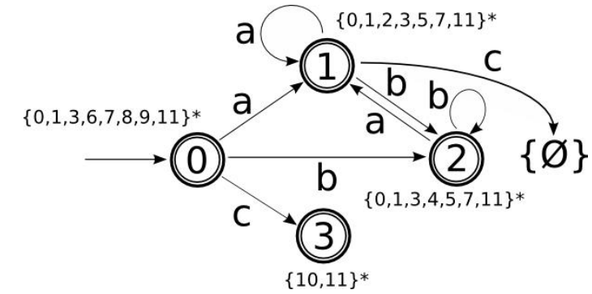
SUBSET Construction Method
Compute 𝜀-closure(move(2, b))
Notes:
D states means DFA states

Slide 43

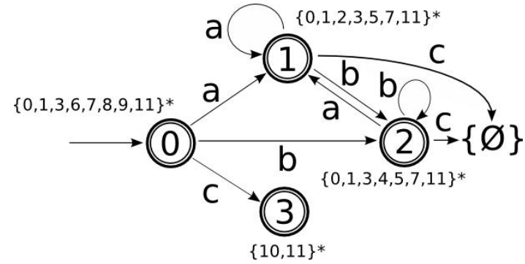
SUBSET Construction Method
Compute 𝜀-closure(move(2, c))
Notes:
D states means DFA states

Slide 44
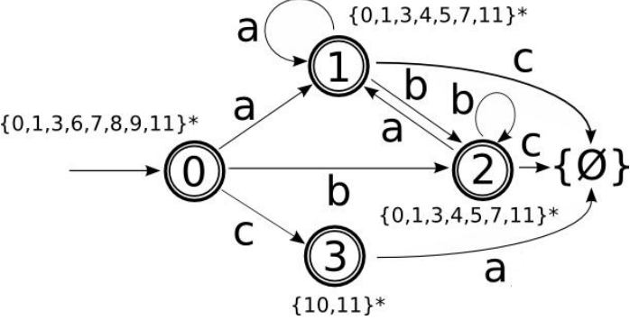
SUBSET Construction Method
Compute 𝜀-closure(move(3, a))
Notes:
D states means DFA states

Slide 45
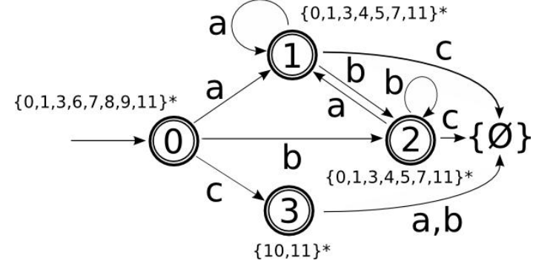
SUBSET Construction Method
Compute 𝜀-closure(move(3, b))
Notes:
D states means DFA states

Slide 46
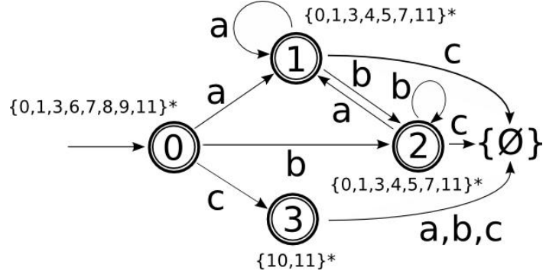
SUBSET Construction Method
Compute 𝜀-closure(move(3, c))
Notes:
D states means DFA states

Slide 47
Another Example
Notes:
D states means DFA states

Slide 48

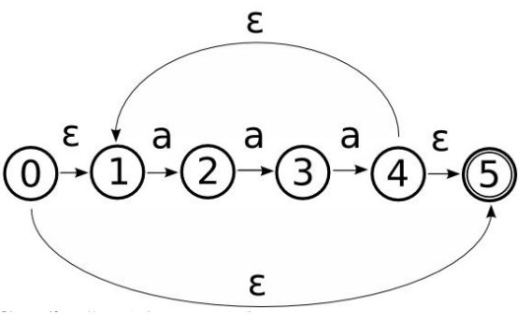
NFA Construction
The concatenation steps to construct the transition graph of aaa are omitted for simplicity

Slide 49

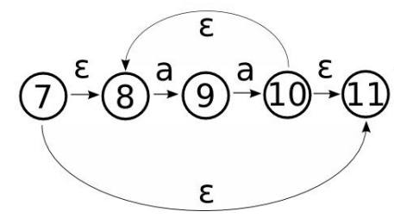
NFA Construction
The concatenation steps to construct the transition graph of aa are omitted for simplicity

Slide 50

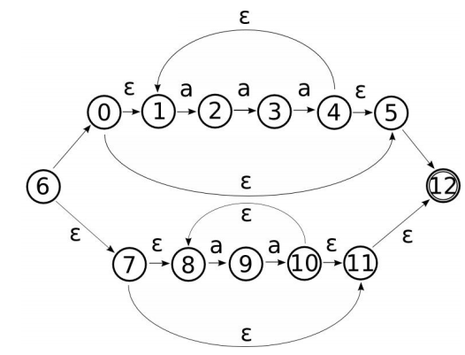
NFA Construction

Slide 51
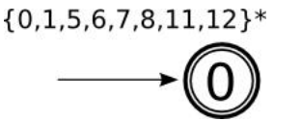
SUBSET Construction Method
First of all we calculate e-closure of start state

Slide 52
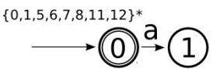
SUBSET Construction Method
Compute 𝜀-closure(move(0, a))
Notes:
D states means DFA states

Slide 53
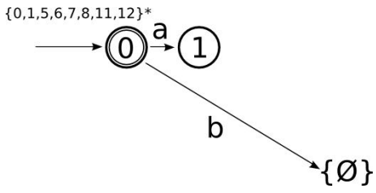
SUBSET Construction Method
Compute 𝜀-closure(move(0, b))
Notes:
D states means DFA states

Slide 54
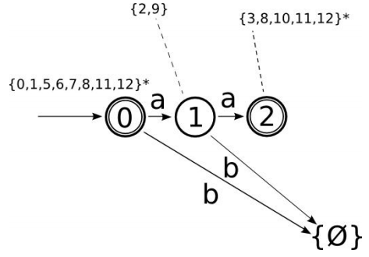
SUBSET Construction Method
Compute 𝜀-closure(move(1, a)) and 𝜀-closure(move(1, b))
Notes:
D states means DFA states

Slide 55
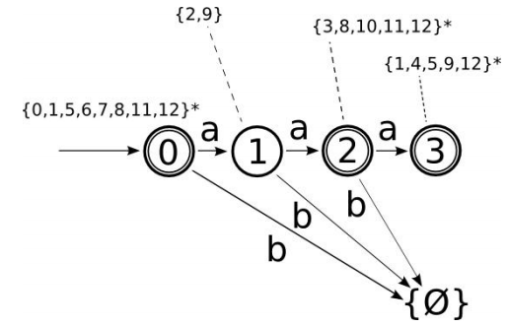
SUBSET Construction Method
Compute 𝜀-closure(move(2, a)) and 𝜀-closure(move(2, b))
Notes:
D states means DFA states

Slide 56
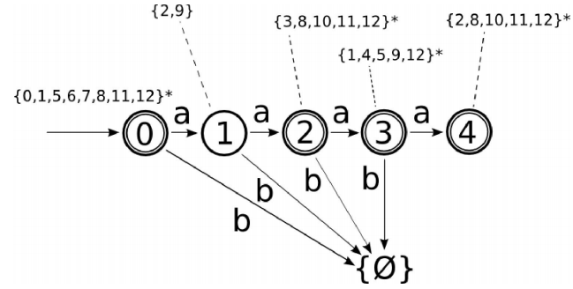
SUBSET Construction Method
Compute 𝜀-closure(move(3, a)) and 𝜀-closure(move(3, b))
Notes:
D states means DFA states

Slide 57
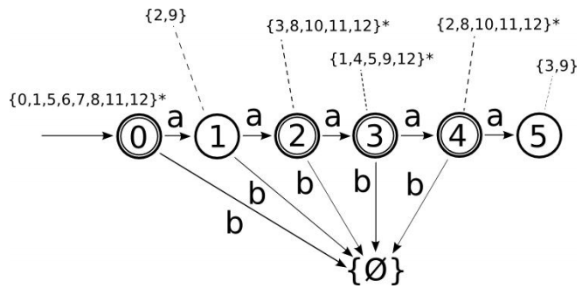
SUBSET Construction Method
Compute 𝜀-closure(move(4, a)) and 𝜀-closure(move(4, b))
Notes:
D states means DFA states

Slide 58


SUBSET Construction Method
Compute 𝜀-closure(move(5, a)) and 𝜀-closure(move(5, b))
Notes:
D states means DFA states

Slide 59

Some more examples of NFA
(aa+bb)*
e-closure(0)={0,1,4,7}*=A

Slide 60

Some more examples of NFA
(a+b)*
e-closure(0)={0,1,2,4,7}=A

Slide 61

Some more examples of NFA
(a+b)*abb
e-closure(0)={0,1,2,4,7}=A

Slide 62
Minimization of DFA
For any DFA there is a DFA with equal or fewer states that matches exactly the same language.
In other words, there can be several DFAs that represent a language, some will be bigger than others and only one will be minimal.
To minimize a DFA three steps must be performed:
Removal of dead states.
Removal of inaccessible states.
Merging of identical states.

Slide 63


Removal of Dead States
A dead states is a state that only leads to itself for every symbol in the alphabet. As we can see in this fairly contrived example:
In the diagram above the non-final state 1, once reached, can never be left. If it was a final state it would be meaningful but as it is it can be disposed of.

Slide 64


Removal of Inaccessible States
An inaccessible state is one that cannot be reached no matter what word is given to the DFA.
As we can see in the above diagram there is no way to ever reach state 1. As such it can be removed.

Slide 65

Merging of Identical States
There are some states that move to exactly to the same states for the same symbols as other states do.

Slide 66

Merging of Identical States
DFA with redundant state_removed

